Slide 1

Permitting Disposal Wells
in the Permian Basin
Paul Dubois, Director of Technical Permitting
Ted Wooten, Chief Engineer
Austin Gaskamp, Engineering Specialist, ISPU
May 22, 2025

Slide 2
Today’s Agenda
History
Applicability
Elements of the Review
Post-Permitting Requirements and Special Conditions
Seismicity
Demonstration

Slide 3
Permian Basin Disposal Well Permitting History (1 of 3)
1982 = Class II UIC Primacy

Slide 4
Permian Basin Disposal Well Permitting History (2 of 3)
1982

Slide 5
Permian Basin Disposal Well Permitting History (3 of 3)
1982

Slide 6
End Points
Current rules and permitting program do not adequately address these risk drivers and challenges.
Water Code §27.051(b)(1-4)
“The Commission …may issue the permit if it finds:”
  The disposal well is in the public interest,
  The disposal well will not endanger or injure any hydrocarbon resources,
  With adequate safeguards, the disposal well will protect freshwater resources from pollution, and
  The applicant has made a satisfactory showing of financial responsibility per Water Code §27.073.

Slide 7
Overview of Changes
Maximum Surface Injection Pressure (MSIP) limited by confinement zone in-situ stress and stress contrast.
Maximum Daily Injection Volume (MDIV) limited by initial average reservoir pressure.
Maximum Injection Rate (MIR) – Instantaneous Rate limitation.
2-mile radial Area of Review (AOR):
  Strict limits within ½ mile
  MSIP reduction within 2-mile on condition

Slide 8
A Note About Public Safety and the Public Interest
We are asking for PE/PG sealing of certain information.
This is consistent with our traditional practice. See our web guidance on:
  Engineering and geologic studies
  Pressure front calculations
  Closure cost estimates for pits associated with commercial disposal wells
  Well log formation correlation and analysis which may be performed for the Area of Review
  Well log interpretation for geologic isolation from freshwater, effective reservoir thickness, etc.
This is the law.
  The practice of engineering is regulated by the Texas Occupations Code, Title 6, Chapter 1001.
  The practice of geoscience is regulated by the Texas Occupations Code, Title 6, Chapter 1002.
Texas Occupations Code Title 6 Subtitle A § 1001.004. LEGISLATIVE PURPOSE AND INTENT; LIBERAL CONSTRUCTION OF CHAPTER.
The legislature recognizes the vital impact that the rapid advance of knowledge of the mathematical, physical, and engineering sciences as applied in the practice of engineering has on the lives, property, economy, and security of state residents and the national defense.
The purpose of this chapter is to:
(1) protect the public health, safety, and welfare;
…

Slide 9
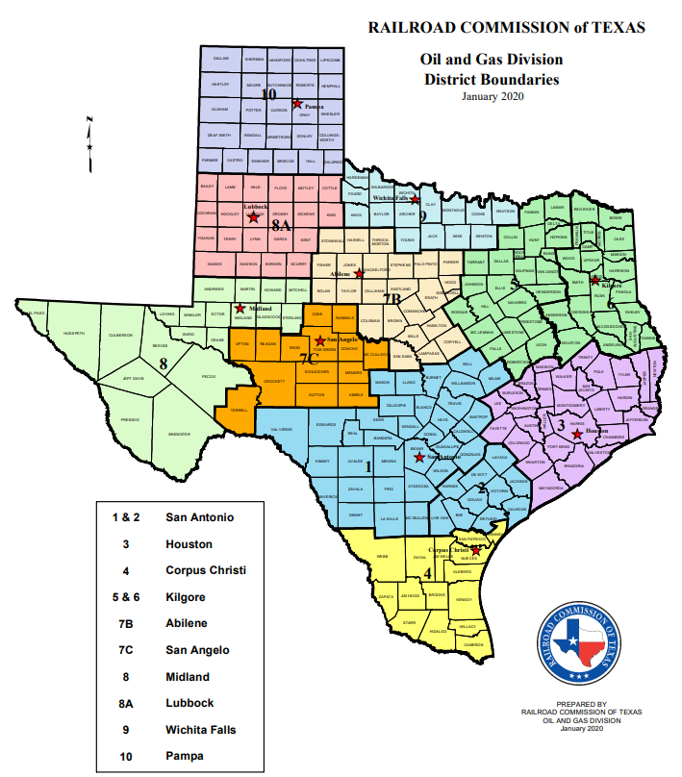
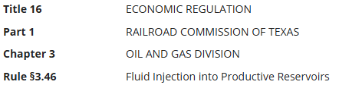
Applicability
All disposal wells in the Permian Basin.
  All SWR 9 Applications
  All SWR 46 Applications with Line 21 box checked for “Disposal”
Permian Basin is defined by RRC Districts 7C, 08, and 8A.

Slide 10

Application Information and Excel Workbook
https://www.rrc.texas.gov/oil-and-gas/applications-and-permits/injection-storage-permits/oil-and-gas-waste-disposal/injection-disposal-permit-procedures/pb-disposal-review/

Slide 11
Permian Basin Disposal Well Application Checklist
Excel Application Workbook (available for download on the RRC Website, Permian Basin Disposal Well Review Page):
  Well Template
  AOR Template
Data Appendix and Report
  Well Data
  AOR Data
Map
Cross Section
Seal of P.E./P.G.

Slide 12
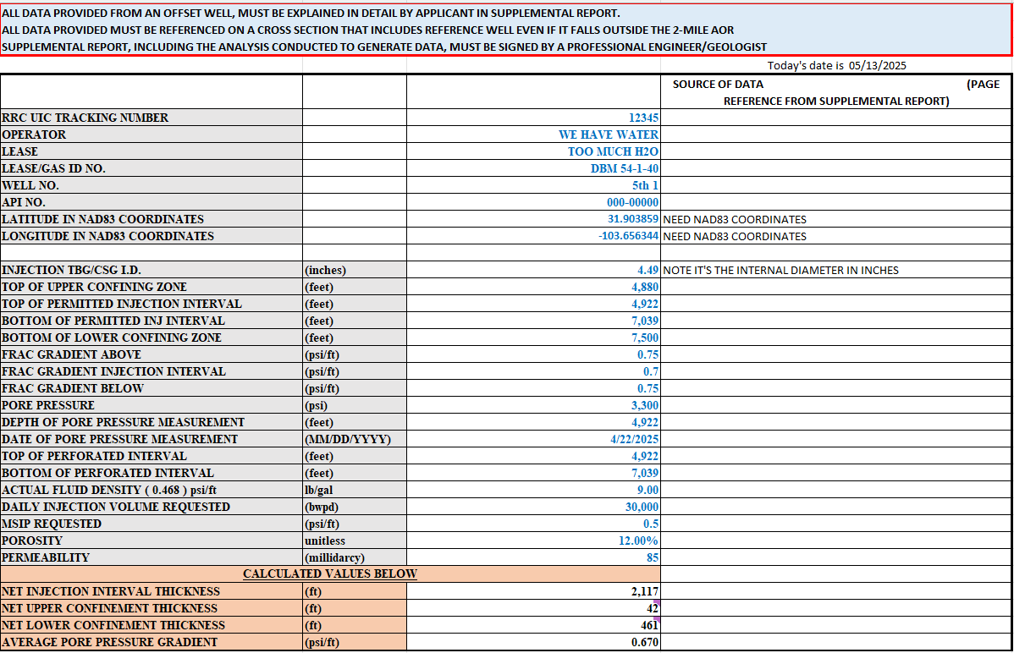
Well Template - Data Input
Basic Info.
Technical Data
Source of Data, Page Numbers to Appendix

Slide 13
Well Template - Confinement
Upper and lower boundaries of the permitted injection interval must prevent fracture growth out the injection interval, as well as act as a permeability barrier.
In-situ minimum stresses (frac gradients): step rate test, sonic log interpretation, diagnostic fracture injection test (DFIT).
  Remember: add reference wells to cross-section.
  Create report and appendix of source data (show your work).

Slide 14
Well Template – Pore Pressure
Average reservoir pressure: BHP measurements, injection / fall-off testing.
Depth Reference for Measurement
Date of Measurement
  Remember: add reference wells to cross-section.
  Create report and appendix of source data (show your work).

Slide 15
Well Template – Permit Interval
Continuous confining interval
Bottom of upper confining interval is assumed to be top of permitted injection interval.
Similarly, bottom of permitted injection interval is assumed to be top of the lower confinement.
Permeability contrast
Stress contrast
Confining intervals above or below: minimum of 25 ft w/ adequate mechanical properties.

Slide 16
Well Template – Other
AVERAGE DENSITY of injection fluids
POROSITY / PERMEABILITY

Slide 17
Well Template – Data Appendix
Well logs may be submitted as image files with the formation contact picks annotated.
Most of the supplemental report documents and reference materials should be collated into a single .pdf file with a table of contents and page numbers.
References on ‘Well Template – Sources of Data’

Slide 18
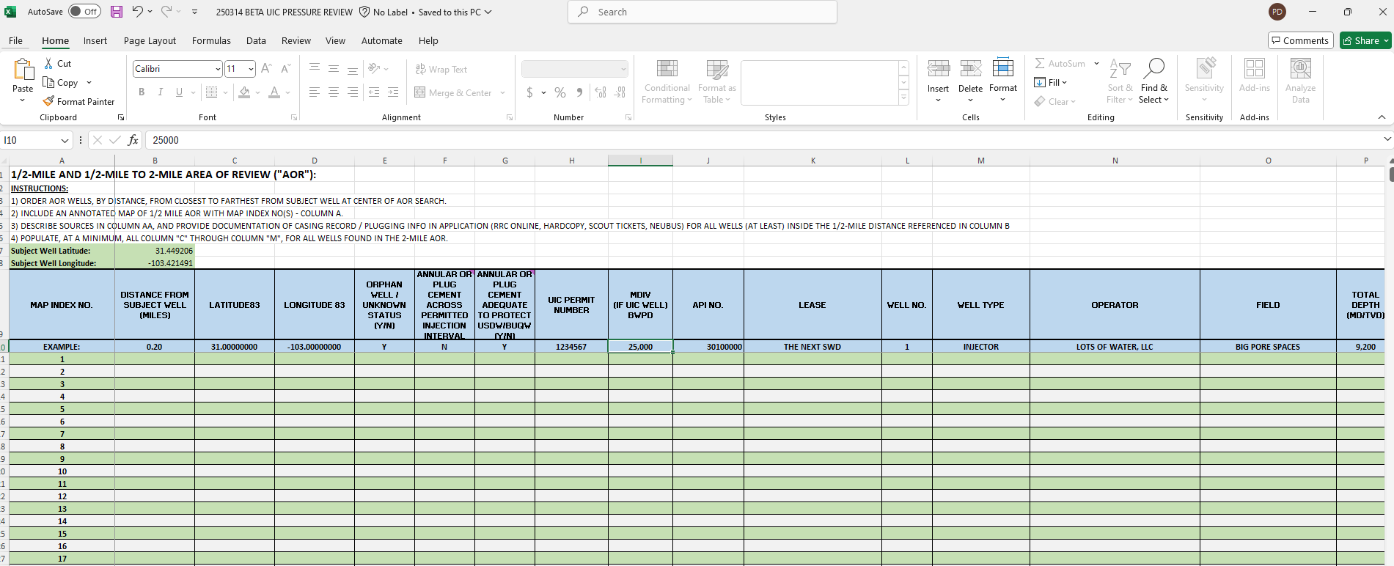
AOR Template – Input Data (1 of 2)

Slide 19
AOR Template – Input Data (2 of 2)
‘AOR Template’ Worksheet:
Sorted by distance
Columns A-AD completed for ½-mile AOR
Columns A-Q completed for 2-mile AOR
If any information is unavailable or not applicable do not estimate, mark clearly as “unavailable” or “NA.”

Slide 20
AOR Criteria: 0 to ½ mile
PASS/FAIL RADIUS OF REVIEW
  Operator is required to assess completion and cementing records of all known wells in the ½-mile radius. Offset wells must:
    have cement across the injection interval and the cement in the offset wells is adequate to keep injected fluids in the injection interval.
    have all applicable plugging records to indicate the BUQW is protected from injection in the subject well.
    contain no orphan wells, improperly plugged or abandoned wells within the ½-mile AOR.

Slide 21
AOR Criteria: ½ to 2 mile
WELLBORE DATA INTEGRITY RADIUS OF REVIEW
  If wells in the area between ½ and 2 miles are classified as orphan wells or have insufficient cementing, plugging or completion records, then the MSIP for that permit will automatically receive a 0.05 psi/ft reduction.

Slide 22
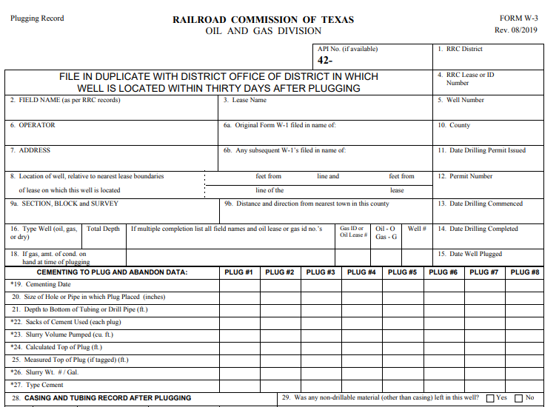
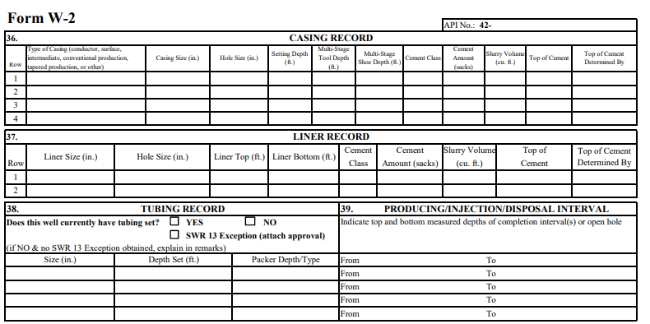
AOR Data - Sources of Data
Plugging Reports
Completion Reports
Other Sources…

Slide 23
Additional Application Attachments
Map showing permit location and offset well locations
  Map should include annotations on well locations that correspond to the index numbers on ‘AOR TEMPLATE’ in Column A.
Cross section across 2-mile AOR
  Operator will provide a cross section, using the best well control available, illustrating the continuity of the primary lithologic units (i.e., bounding layers, injection intervals) across the 2-mile circular area of review.
    Include annotations for the tops and bottoms of the injection and confining intervals.
    Include annotations for the referenced pore pressure (measured pressure and depth reference)
    Include fracture gradient reference with depth reference.
    Include API No. / UIC# / Lat-Long (NAD83) for wells used.

Slide 24
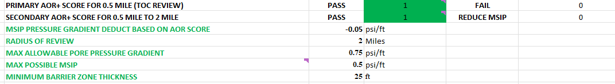
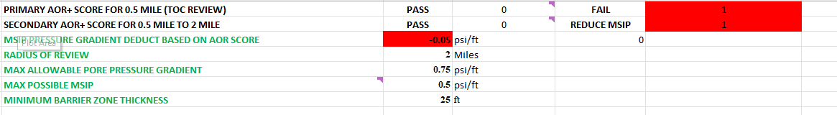
AOR Data – Output
Impact of AOR Results:

Slide 25
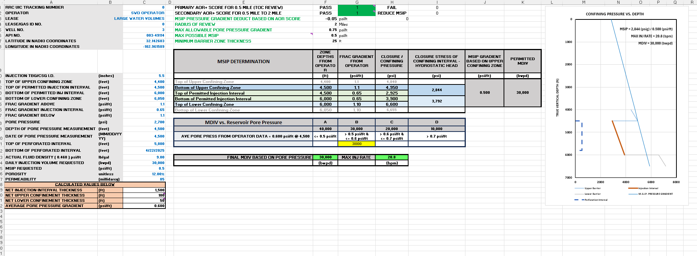
MSIP & MDIV: Dashboard

Slide 26
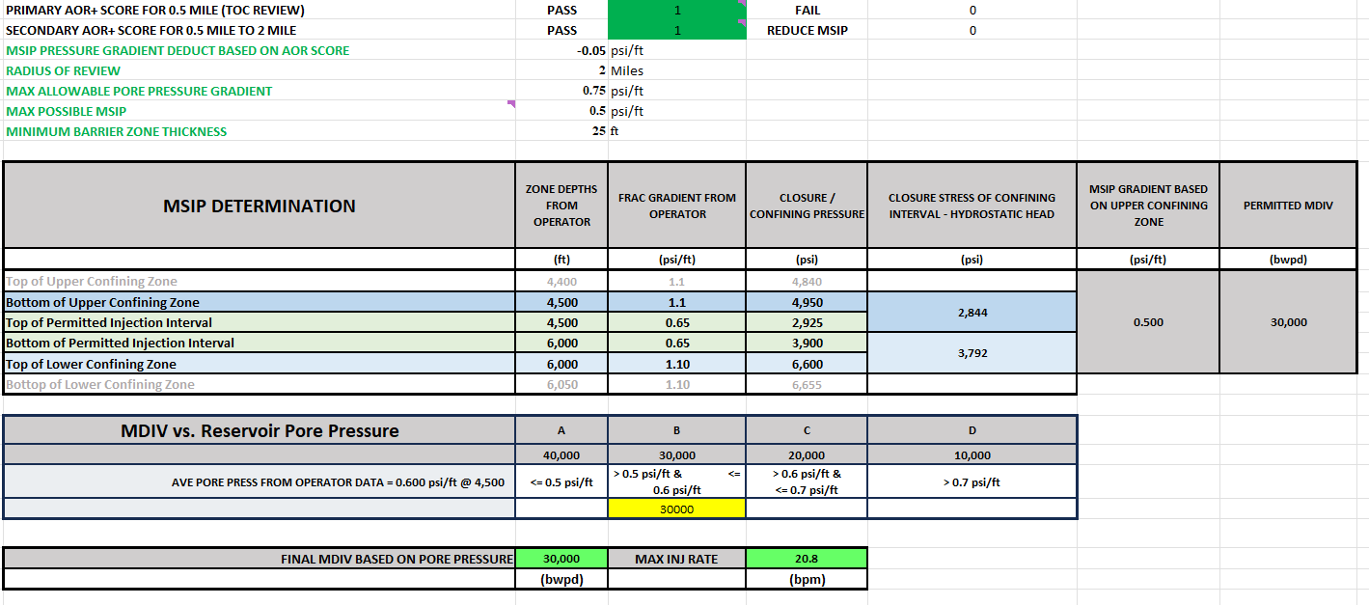
Output: Maximum Surface Injection Pressure (1 of 2)
MSIP will be determined by calculating confining stresses of barriers:

Slide 27
Output: Maximum Surface Injection Pressure (2 of 2)
MSIP will be determined using the following methodology:
MSIP determination | Depth | Closure stress | MSIP
Upper confinement Parameters | 4000 | 1.00 psi/ft | 2,140
Lower confinement Parameters | 6000 | 0.80 psi/ft | 2,010
capped at
0.50 psi/ft
Example Calculation – (1.00 – 0.465) X 4,000 = 2,140 PSI (upper)
Example Calculation – (0.80 – 0.465) X 6,000 = 2,010 PSI (lower)
MSIP (gradient) allowed = lower of the two values determined – 2,010 PSI (this time the lower layer with a cap of 0.50 psi/ft times the top of the zone) will be divided by the depth to the top of the permitted injection interval.
Example Calculation: 2,010 ÷ 4,000 = 0.5025 psi/ft > 0.5 => MSIP = 0.5 psi/ft

Slide 28
Output: Maximum Daily Injection Volume
MDIV will be determined using the following methodology:
  Maximum Daily Injection Volume (MDIV) will be determined using
    Initial Average Reservoir Pressure

Slide 29
Output: Maximum Injection Rate
MIR will be determined by MDIV (barrels/day) ÷ 1,440 minutes/day = (bbl/min.)

Slide 30
Well Completion & Permit Conditions – Page 1 of 2
Initial Bottomhole Pressure (BHP): data point prior to injection.
Initial fracture gradient: DFIT or STEP RATE TEST, prior to injection, submitted via sealed report to UIC & to TexNet - analysis to be included with a digital (i.e., txt, csv, EXCEL) copy of the entire test including time, rate, pressure.
Radial CBLs on long string casing.
Log Suite, or best available data source, with annotation of upper and lower confinement (if possible) and lithologic units, and net pay highlighted, confirming porosity-height product for entire permitted injection interval.

Slide 31
Well Completion & Permit Conditions – Page 2 of 2
Bottomhole Pressure Reporting:
  Annual Frequency.
  Instantaneous shut-in pressure measurement.
  24-hour shut-in time.
  BHP: Downhole gauge, Dip-in measurement, Calculated.
  Reported to TexNet and UIC.
TexNet Volume Reporting – Daily measurement /Monthly Reporting.

Slide 32
Seismicity – Page 1 of 2
In the Permian Basin, we will continue to observe the “Shallow/Deep” conventions as currently practiced:
  Delaware Basin: Shallow is above the base of the Wolfcamp; deep is below.
  Midland Basin: Shallow is above the top of the Strawn; deep is below.
Applications in seismically active areas will need to provide data required by seismic guidelines (ex. maps and cross sections)

Slide 33
Seismicity – Page 2 of 2
“Shallow” applications will
  Generally, not need Fault Slip Potential analysis.
  Be evaluated under the Permian Review rubric, not the Seismic Guidelines (i.e. MDIV and MSIP determined by min. stress and Ppi.)
However, the State Seismologists may identify an area in which seismicity from shallow injection is a concern and subject applications in such an area to evaluation under the seismic guidelines.

Slide 34
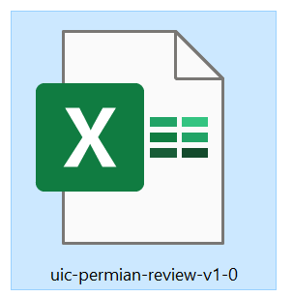
Demonstration
UIC Permian Pressure Review V1.0 Workbook
  uic-permian-review-v1-0

