Slide 1

Permitting Disposal Wells
in the Permian Basin
Paul Dubois, Director of Technical Permitting
Ted Wooten, Chief Engineer
Austin Gaskamp, Engineering Specialist, UIC
May 22, 2025

Slide 2
Today’s Agenda
History
Applicability
Elements of the Review
Application Attachments
MDIV, MSIP, MIR Determination
Post-Permitting Requirements and Special Conditions
Seismicity
Resources

Slide 3
Permian Basin Disposal Well Permitting History (1 of 3)
1982 = Class II UIC Primacy

Slide 4
Permian Basin Disposal Well Permitting History (2 of 3)
1982

Slide 5
Permian Basin Disposal Well Permitting History (3 of 3)
1982

Slide 6
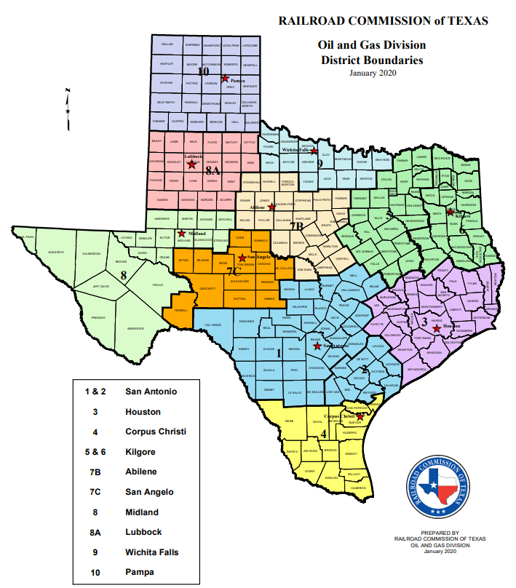
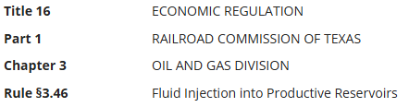
Applicability
All disposal wells in the Permian Basin.
Permian Basin is defined by RRC Districts 7C, 08, and 8A.
SWR 9 & 46 (16 TAC §3.9, 3.46), excludes waterflood / EOR injection projects.

Slide 7
Overview of Changes
Maximum Surface Injection Pressure (MSIP) limited by confinement zone in-situ stress and stress contrast.
Maximum Daily Injection Volume (MDIV) limited by initial average reservoir pressure.
2-mile radial Area of Review (AOR):
Strict limits within ½ mile
MSIP reduction within 2-mile on condition
Maximum Injection Rate (MIR) – Instantaneous Rate limitation.

Slide 8
Permian Basin Disposal Well Application Checklist
Excel Application Workbook (available for download on the RRC Website, Permian Dasin Disposal Well Review Page):
Well Template
AOR Template
Map
Cross Section
Data Appendix and Report
Well Data
AOR Data
Seal of P.E./P.G.

Slide 9
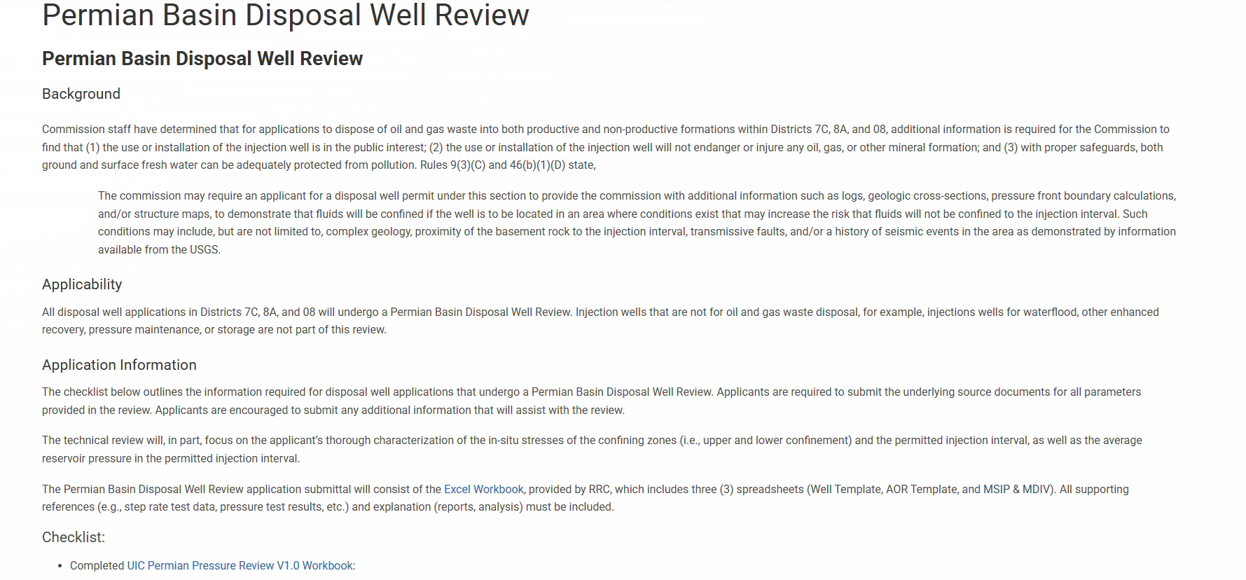
Application Excel Workbook

Slide 10
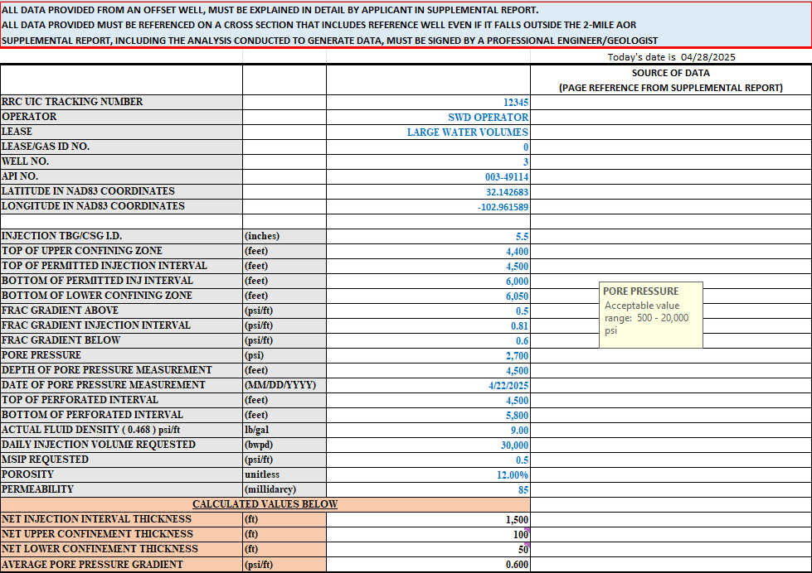
Well Template - Data Input - Page 1 of 4
Well Info
Reservoir and Confinement Data
Source of Data, Page Numbers

Slide 11
Well Template - Parameters - Page 2 of 4
UPPER CONFINEMENT ZONE above the permitted injection interval
Depth to top of upper confinement zone
Depth to bottom of upper confinement zone
Frac gradient for upper confinement zone
PERMITTED INJECTION INTERVAL
Depth to top of permitted injection interval
Depth to bottom of permitted injection interval
Frac gradient for permitted injection interval
Initial average reservoir pore pressure for permitted injection interval, including reference depth and date of measurement
LOWER CONFINEMENT ZONE below the permitted injection interval
Depth to top of lower confinement zone
Depth to bottom of lower confinement zone
Frac gradient for lower confinement zone
Upper and lower boundaries of the permitted injection interval must be mechanically competent to prevent fracture growth out the injection interval, as well as act as a permeability barrier.
Bottom of upper confining interval is assumed to be top of permitted injection interval. Similarly, bottom of permitted injection interval is assumed to be top of the lower confinement.

Slide 12
Well Template - Parameters - Page 3 of 4
PERFORATED INTERVAL (if different from the Permitted Interval)
Top of perforated interval
Bottom of perforated interval
Depth to pore pressure reference
AVERAGE DENSITY of permitted injection fluids
POROSITY / PERMEABILITY

Slide 13
Well Template - Sources of Data
In-situ minimum stresses (frac gradients): step rate test, sonic log interpretation, diagnostic fracture injection test (DFIT).
Average reservoir pressure: BHP measurements, injection / fall-off testing.
Remember: add reference wells to cross-section.
Create report and appendix of source data (show your work).

Slide 14
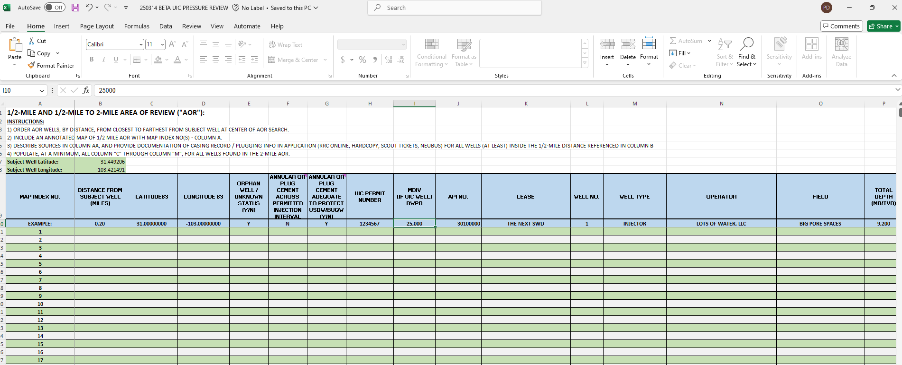
AOR Template – Input Data

Slide 15
AOR Criteria: 0 to ½ mile
PASS/FAIL RADIUS OF REVIEW
Operator is required to assess completion and cementing records of all known wells in the ½-mile radius. Offset wells must:
have cement across the injection interval and the cement in the offset wells is adequate to keep injected fluids in the injection interval.
have all applicable plugging records to indicate the BUQW is protected from injection in the subject well.
contain no orphan wells, improperly plugged, or abandoned wells within the ½-mile AOR.

Slide 16
AOR Criteria: ½ to 2 mile
WELLBORE DATA INTEGRITY RADIUS OF REVIEW
If wells in the area between ½ and 2 miles are classified as orphan wells or have insufficient cementing, plugging or completion records, then the MSIP for that permit will automatically receive a 0.05 psi/ft reduction.

Slide 17
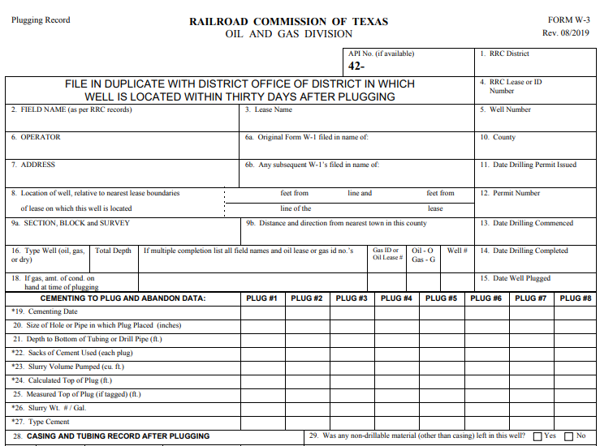
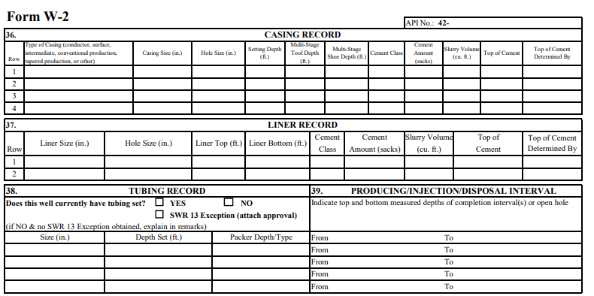
AOR Data - Sources of Data
Plugging Reports
Completion Reports
Other Sources…

Slide 18
Additional Application Attachments
Map showing permit location and offset well locations
Map should include annotations on well locations that correspond to the index numbers on ‘AOR TEMPLATE’ in Column A.
Verified confining layers
Operator will provide a well log with adequate annotation illustrating a vertically contiguous confining layer thickness of at least 25 ft in vertical thickness. This pertains to the designation of what constitutes a barrier to vertical fluid migration within the reservoir.
Cross section across 2-mile AOR
Operator will provide a cross section, using the best well control available, illustrating the continuity of the primary lithologic units (i.e., bounding layers, injection intervals) across the 2-mile circular area of review.

Slide 19
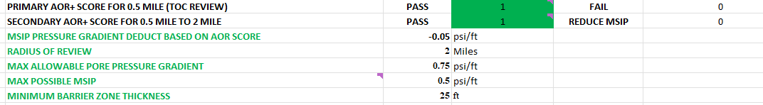
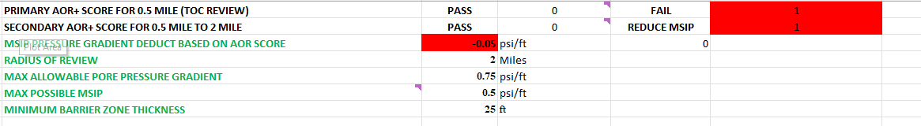
AOR Data – Output
Impact of AOR Results:

Slide 20
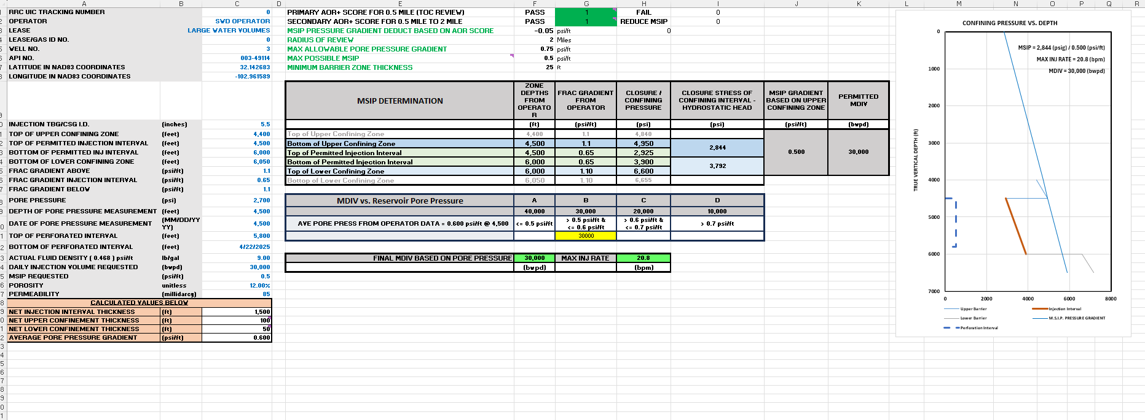
MSIP & MDIV: Output

Slide 21
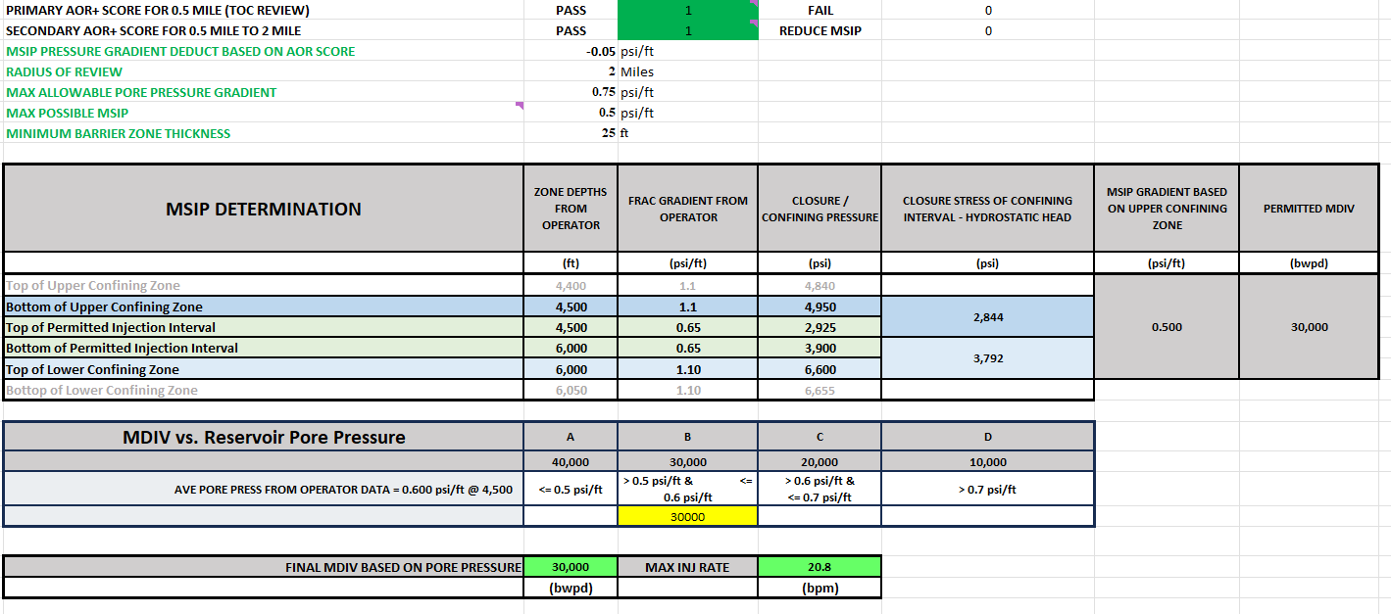
Output: Maximum Surface Injection Pressure
MSIP will be determined by calculating confining stresses of barriers:

Slide 22
Output: Maximum Surface Injection Pressure
MSIP will be determined using the following methodology:
MSIP determination | Depth | Closure stress | MSIP
Upper confinement Parameters | 4000 | 1.00 psi/ft | 2,140
Lower confinement Parameters | 6000 | 0.80 psi/ft | 2,010
capped at
0.50 psi/ft
Example Calculation – (1.00 – 0.465) X 4,000 = 2,140 PSI (upper)
Example Calculation – (0.80 – 0.465) X 6,000 = 2,010 PSI (lower)
MSIP (gradient) allowed = lower of the two values determined – 2,010 PSI (this time the lower layer with a cap of 0.50 psi/ft times the top of the zone) will be divided by the depth to the top of the permitted injection interval.
Example Calculation: 2,010 ÷ 4,000 = 0.5025 psi/ft > 0.5 => MSIP = 0.5 psi/ft

Slide 23
Output: Maximum Daily Injection Volume
MDIV will be determined using the following methodology:
Maximum Daily Injection Volume (MDIV) will be determined using
Initial Average Reservoir Pressure

Slide 24
Output: Maximum Injection Rate
MIR will be determined by MDIV barrels/day ÷ 1,440 minutes/day = (bbl/min.)

Slide 25
Seismicity – Page 1 of 2
In the Permian Basin, we will continue to observe the “Shallow/Deep” conventions as currently practiced:
Delaware Basin: Shallow is above the base of the Wolfcamp; deep is below.
Midland Basin: Shallow is above the top of the Strawn; deep is below.
Applications in seismically active areas will need to provide data required by seismic guidelines (ex. logs and cross sections)

Slide 26
Seismicity – Page 2 of 2
“Shallow” applications will
Generally, not need Fault Slip Potential analysis.
Be evaluated under the Permian Review rubric, not the Seismic Guidelines (i.e. MDIV and MSIP determined by stress and Ppi.)
However, the State Seismologists may identify an area in which seismicity from shallow injection is a concern and subject applications in such an area to evaluation under the seismic guidelines.

Slide 27
Well Completion & Permit Conditions – Page 1 of 2
Initial Bottom hole Pressure (BHP): data point prior to injection.
Initial fracture Gradient: DFIT or STEP RATE TEST, prior to injection, submitted via sealed report to UIC & to TexNet - analysis to be included with a digital (i.e., txt, csv, EXCEL) copy of the entire test including time, rate, pressure.
Radial CBLs on long string casing.
Log Suite, or best available data source, with annotation of upper and lower confinement (if possible) and lithologic units, and net pay highlighted, confirming porosity-height product for entire permitted injection interval.

Slide 28
Well Completion & Permit Conditions – Page 2 of 2
Ongoing TexNet Pressure Reporting – BHP (either from BHP gauge, or using an ISIP + hydrostatic head estimate) & 24-48 hours SI time to measure and report BHP (either from BHP gauge, or using a surface shut in pressure + hydrostatic head estimate).
TexNet Volume Reporting – Daily measurement /Monthly Reporting.

Slide 29
Guiding Concerns
Will the injected fluids remain confined to permitted interval (subsurface formation)?
If operator injects above the hydraulic fracturing pressure will the fracture created allow fluids to migrate vertically outside the permitted interval?
If operator injects below the hydraulic fracturing pressure, how do we ensure the stratigraphic (permeability) zone(s) confining those fluids are contiguous across the entire AOR?
What zone thickness constitutes an impermeable or mechanical barrier to confine injected fluids and a hydraulic fracture?
If the fluid and pressure plume reach other wells, will the fluids still remain confined to the permitted interval, or will they adversely affect production from that formation or possibly encounter USDW/BUQW?

Slide 30
Resources
Links to Website
Downloads (Template)

